Slide 1



Python Project
Autodice classes Internship
Year:Dec,2019-jan,2020

Slide 2
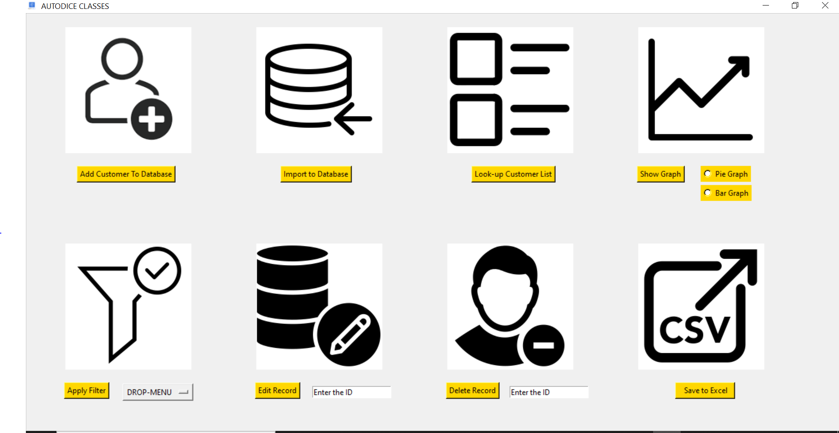
CUSTOMER RELATIONAL MANAGER
CRM is used to manage customer information for various analysis done in business.

Slide 3


OPERATIONS OF CRM
Insert the customer into database
Delete the customer from the database

Slide 4


OPERATIONS OF CRM
edit the records of customer
Creates a csv file of record present in database

Slide 5


OPERATIONS OF CRM
Export the data in excel to the database
opens a new window to see the list of customer present in
database.

Slide 6


OPERARTIONS OF CRM
Filter the customer list according to category.
creates a graph depending on number of categories.

